Slide 1
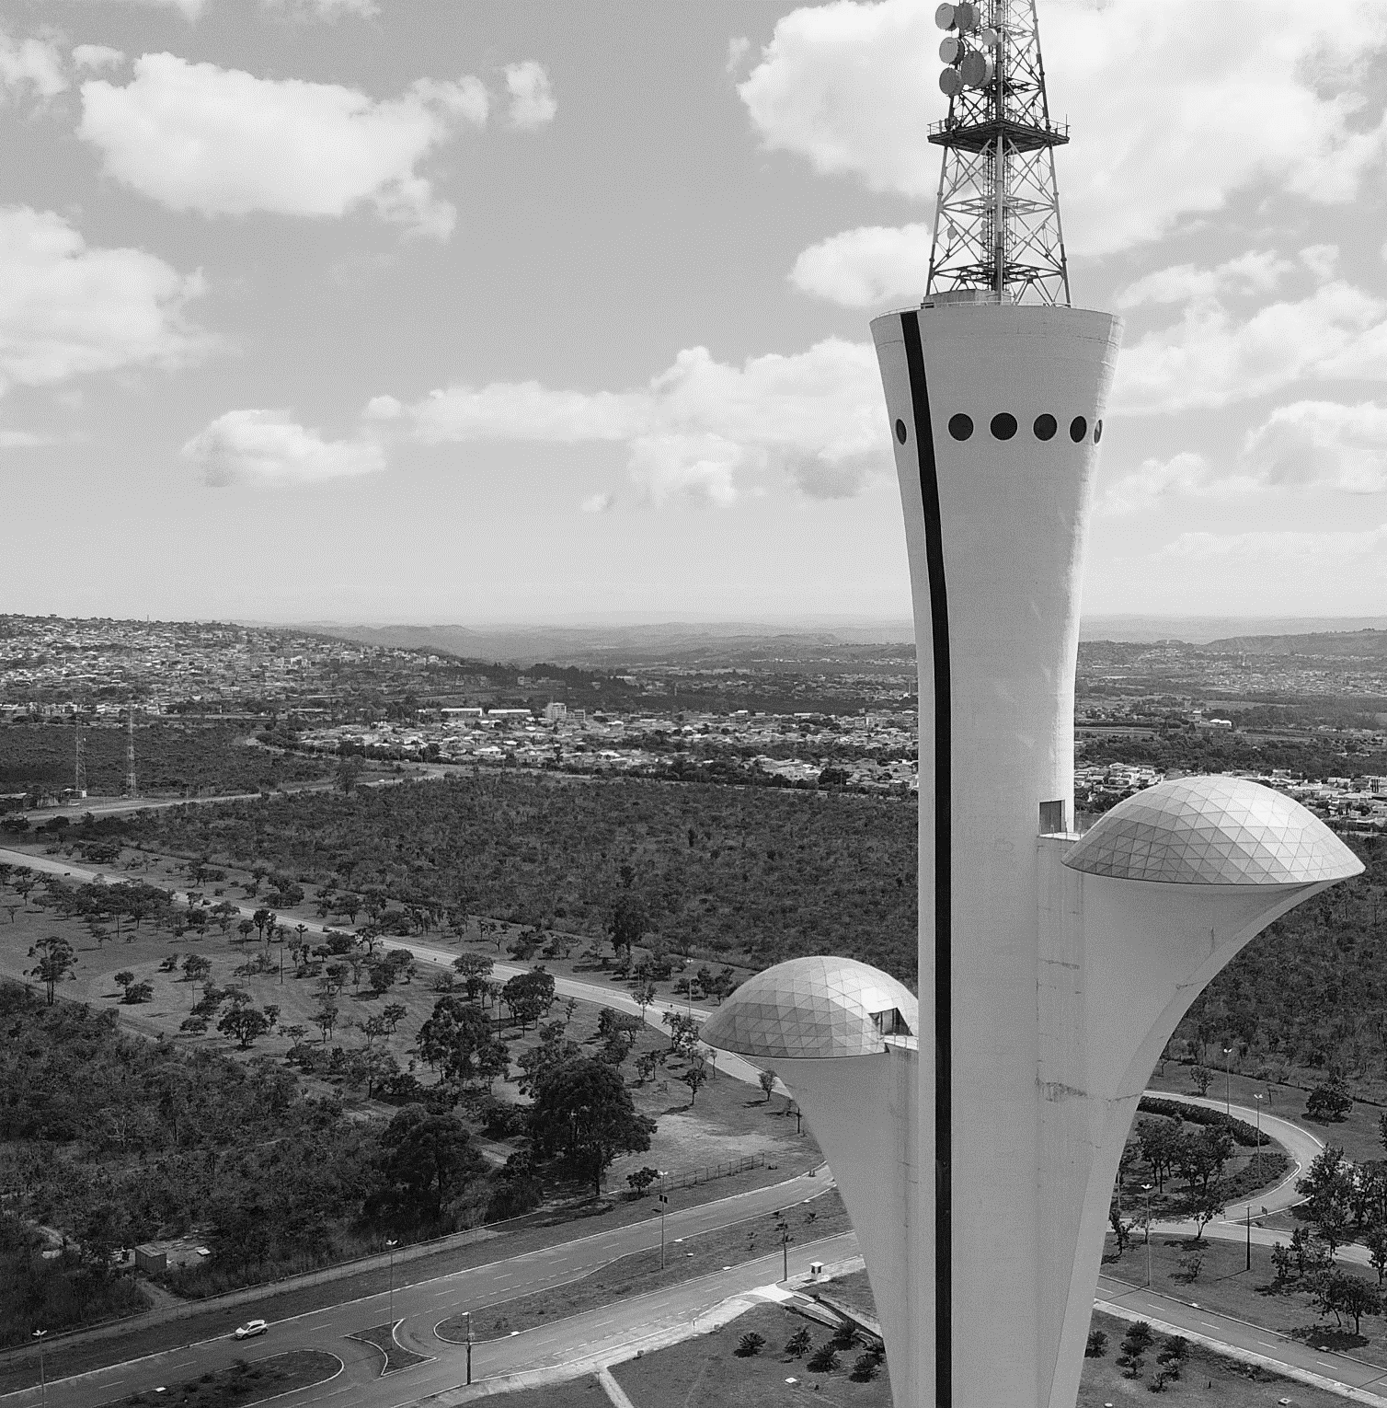
III Brazilian Aerospace Congress
Brasilia, DF, Brazil
September 22nd to 24th, 2025
Welcome to the III Brazilian Aerospace Congress
Authors
Institution/Company

Slide 2
Title
Development

Slide 3
Acknowledgements
Contact
Thank You!
III Brazilian Aerospace Congress
Brasilia, DF, Brazil
September 22nd to 24th, 2025

